Slide 1
PART II

Slide 2

RUNGTA COLLEGE OF DENTAL SCIENCES & RESEARCH
TITLE OF THE TOPIC- PREVENTIVE ORTHODONTICS
DEPARTMENT OF ORTHODONTICS AND DENTOFACIAL ORTHOPAEDICS

Slide 3
Specific learning Objectives
CORE AREAS | DOMAIN | CATEGORY
Preventive Orthodontics Definition | AFFECTIVE | DESIRE TO KNOW
Procedures in Preventive Orthodontics | COGNITIVE | MUST KNOW
SPACE MAINTENANCE | PSYCHOMOTOR | MUST KNOW
INDICATIONS | AFFECTIVE | NICE TO KNOW
ADVANTAGES | COGNITIVE | NICE TO KNOW

Slide 4
CONTENTS
PART I
Preventive Orthodontics Definition
Procedures in Preventive Orthodontics
1 Patient and Parent Education
2 Caries Control
3 Care of Deciduous Dentition
4 Management of ankylosed tooth
5 Maintenance of Shedding timetable
6 Checkup for Oral habits & habit breaking appliances
7 Occlusal Equilibrium
8 Prevention of damage to Occlusion
9 Extraction of Supernumerary Teeth
10 Management of locked 1st permanent molars
11 Management of abnormal frenal attachment
PART II
12 Space maintenance
a. Definition
b. Ideal Requirements
c. Classification
d. Removable space maintainers

Slide 5
CONTENTS (contd…)
e. Fixed space maintainers : Examples
~Band and loop space maintainer
~Crown and loop space maintainer
~Lingual arch space maintainer
~Palatal arch space maintainer
~Transpalatal arch space maintainer
~Distal shoe space maintainer
Indications, Contraindications
~Band and bar space maintainer
~Crown and bar space maintainer
~Preformed banded space maintainer
—Advantages & Disadvantages of Fixed space maintainer

Slide 6
13) Space maintenance
Space Maintainer: (Definition)Space maintenance can be defined as the provision of an appliance (active or passive) which is concerned only with the control of space loss without taking into consideration measures to supervise the development of dentition.

Slide 7
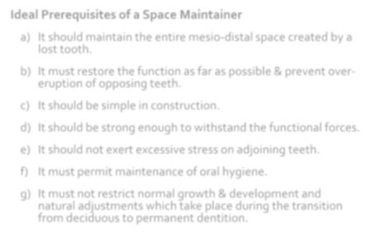
13) Space maintenance
Cont…
Ideal Prerequisites of a Space Maintainer
It should maintain the entire mesio-distal space created by a
lost tooth.
It must restore the function as far as possible & prevent over- eruption of opposing teeth.
It should be simple in construction.
It should be strong enough to withstand the functional forces.
It should not exert excessive stress on adjoining teeth.
It must permit maintenance of oral hygiene.
It must not restrict normal growth & development and natural adjustments which take place during the transition from deciduous to permanent dentition.

Slide 8
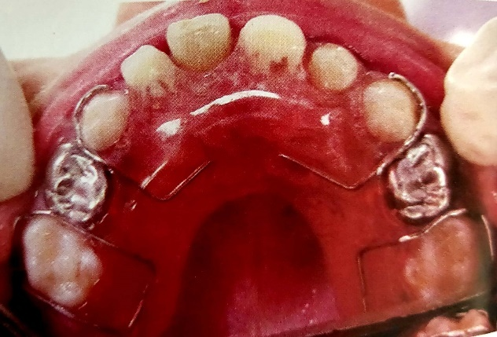
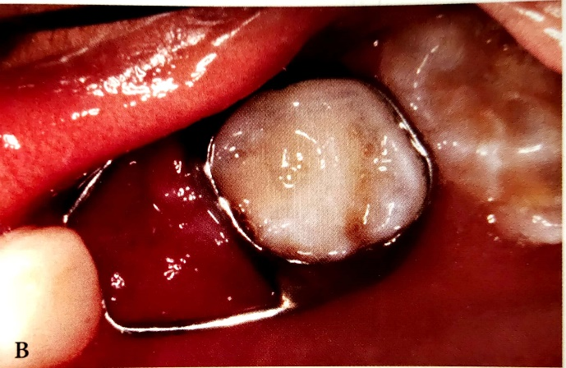
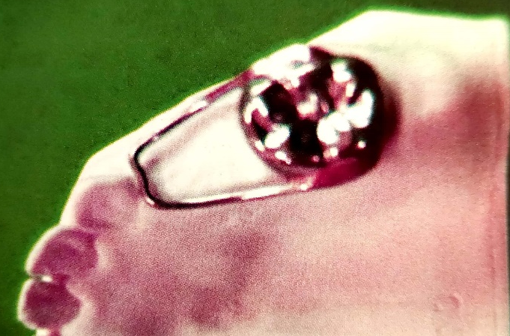
Classification of space maintainers
According to Hitchcock
Removable or fixed or semifixed.
With bands or without bands.
Functional or non functional
Active or passive.
Combinations of the above.

Slide 9
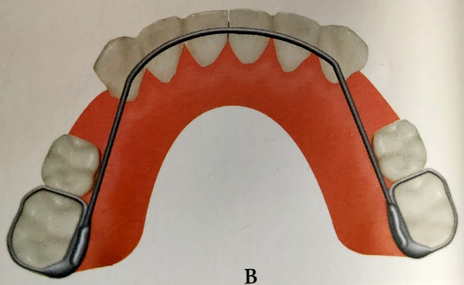
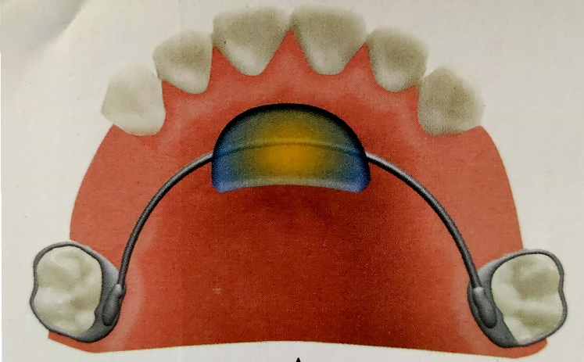
According to Raymond C. Thurow
Removable.
Complete arch
Lingual arch
Extraoral anchorage
a) Individual tooth space maintainer

Slide 10
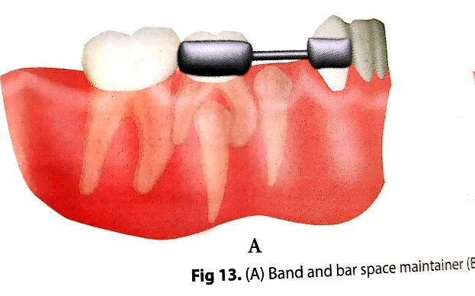
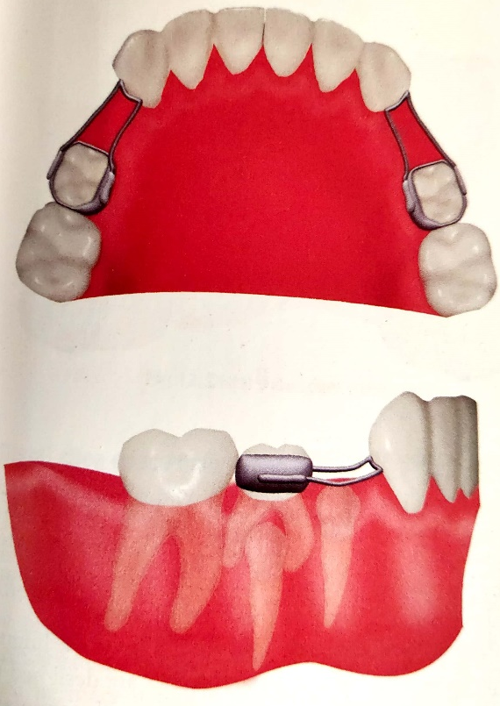
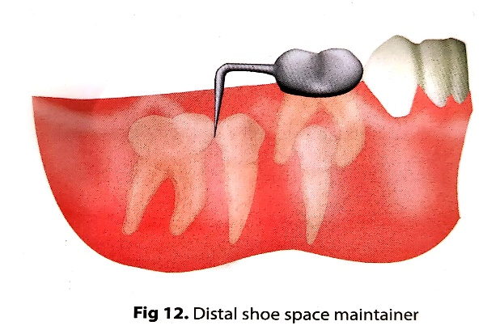
According to Hinrichsen
Fixed space maintainers
Class I
Non-functional types
Bar types.
Loop type
Functional type
Pontic type
Lingual arch type
Class II
Cantilever type
2. Removable Space maintainers:
 Acrylic partial dentures.

Slide 11
Removable space maintainers
They are space maintainers that can be removed and reinserted into the oral cavity by the patient.
It can be functional or non-functional.
Functional: teeth provided to aid in mastication,speech and aesthetics.
Non-functional: only an acrylic extension over edentulous area to prevent space closure

Slide 12
Indications:
When esthetics is of importance.
When abutment teeth cannot support fixed appliance
Cleft palate patients: for obturation of palatal defects.
If radiographs reveal that the unerupted permanent tooth is not going to erupt in less than 5 months.
If permanent teeth are not fully erupted so a band cannot be adapted.
Multiple loss of deciduous teeth requiring functional replacement.

Slide 13
Contraindications:
Lack of patient co-operation
Allergy to acrylic
Epileptic patients having uncontrolled seizures.

Slide 14
Some commonly used removable space maintainers
Acrylic partial denture
Full or complete dentures
Removable distal shoe space maintainer

Slide 15
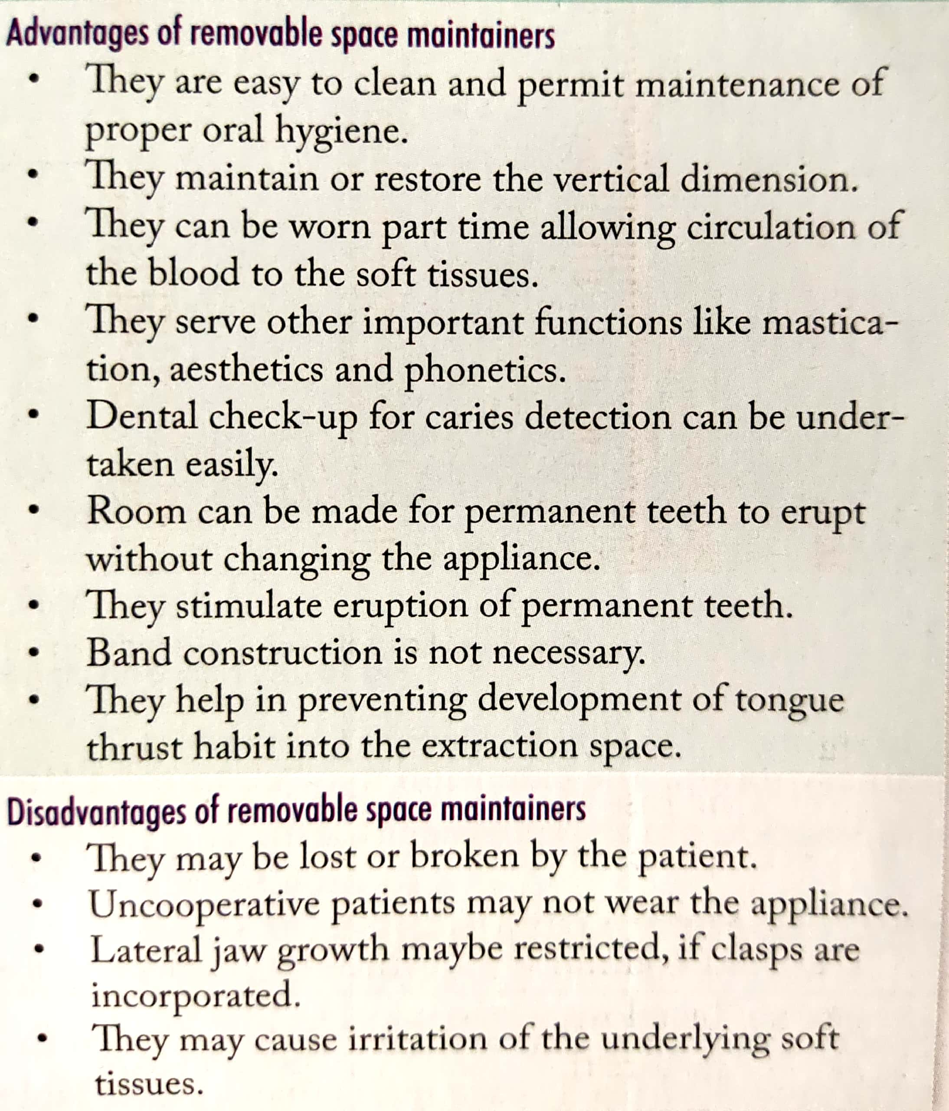
Advantages of removable space maintainers

Slide 16
Disadvantages of removable space maintainers

Slide 17

Fixed space maintainers
Space maintainers that are fixed or fitted on to the teeth are called fixed space maintainers.
Examples of fixed space maintainers.
1. Crown and loop appliance

Slide 18


Band and loop space maintainers

Slide 19

Lingual arch space maintainers

Slide 20
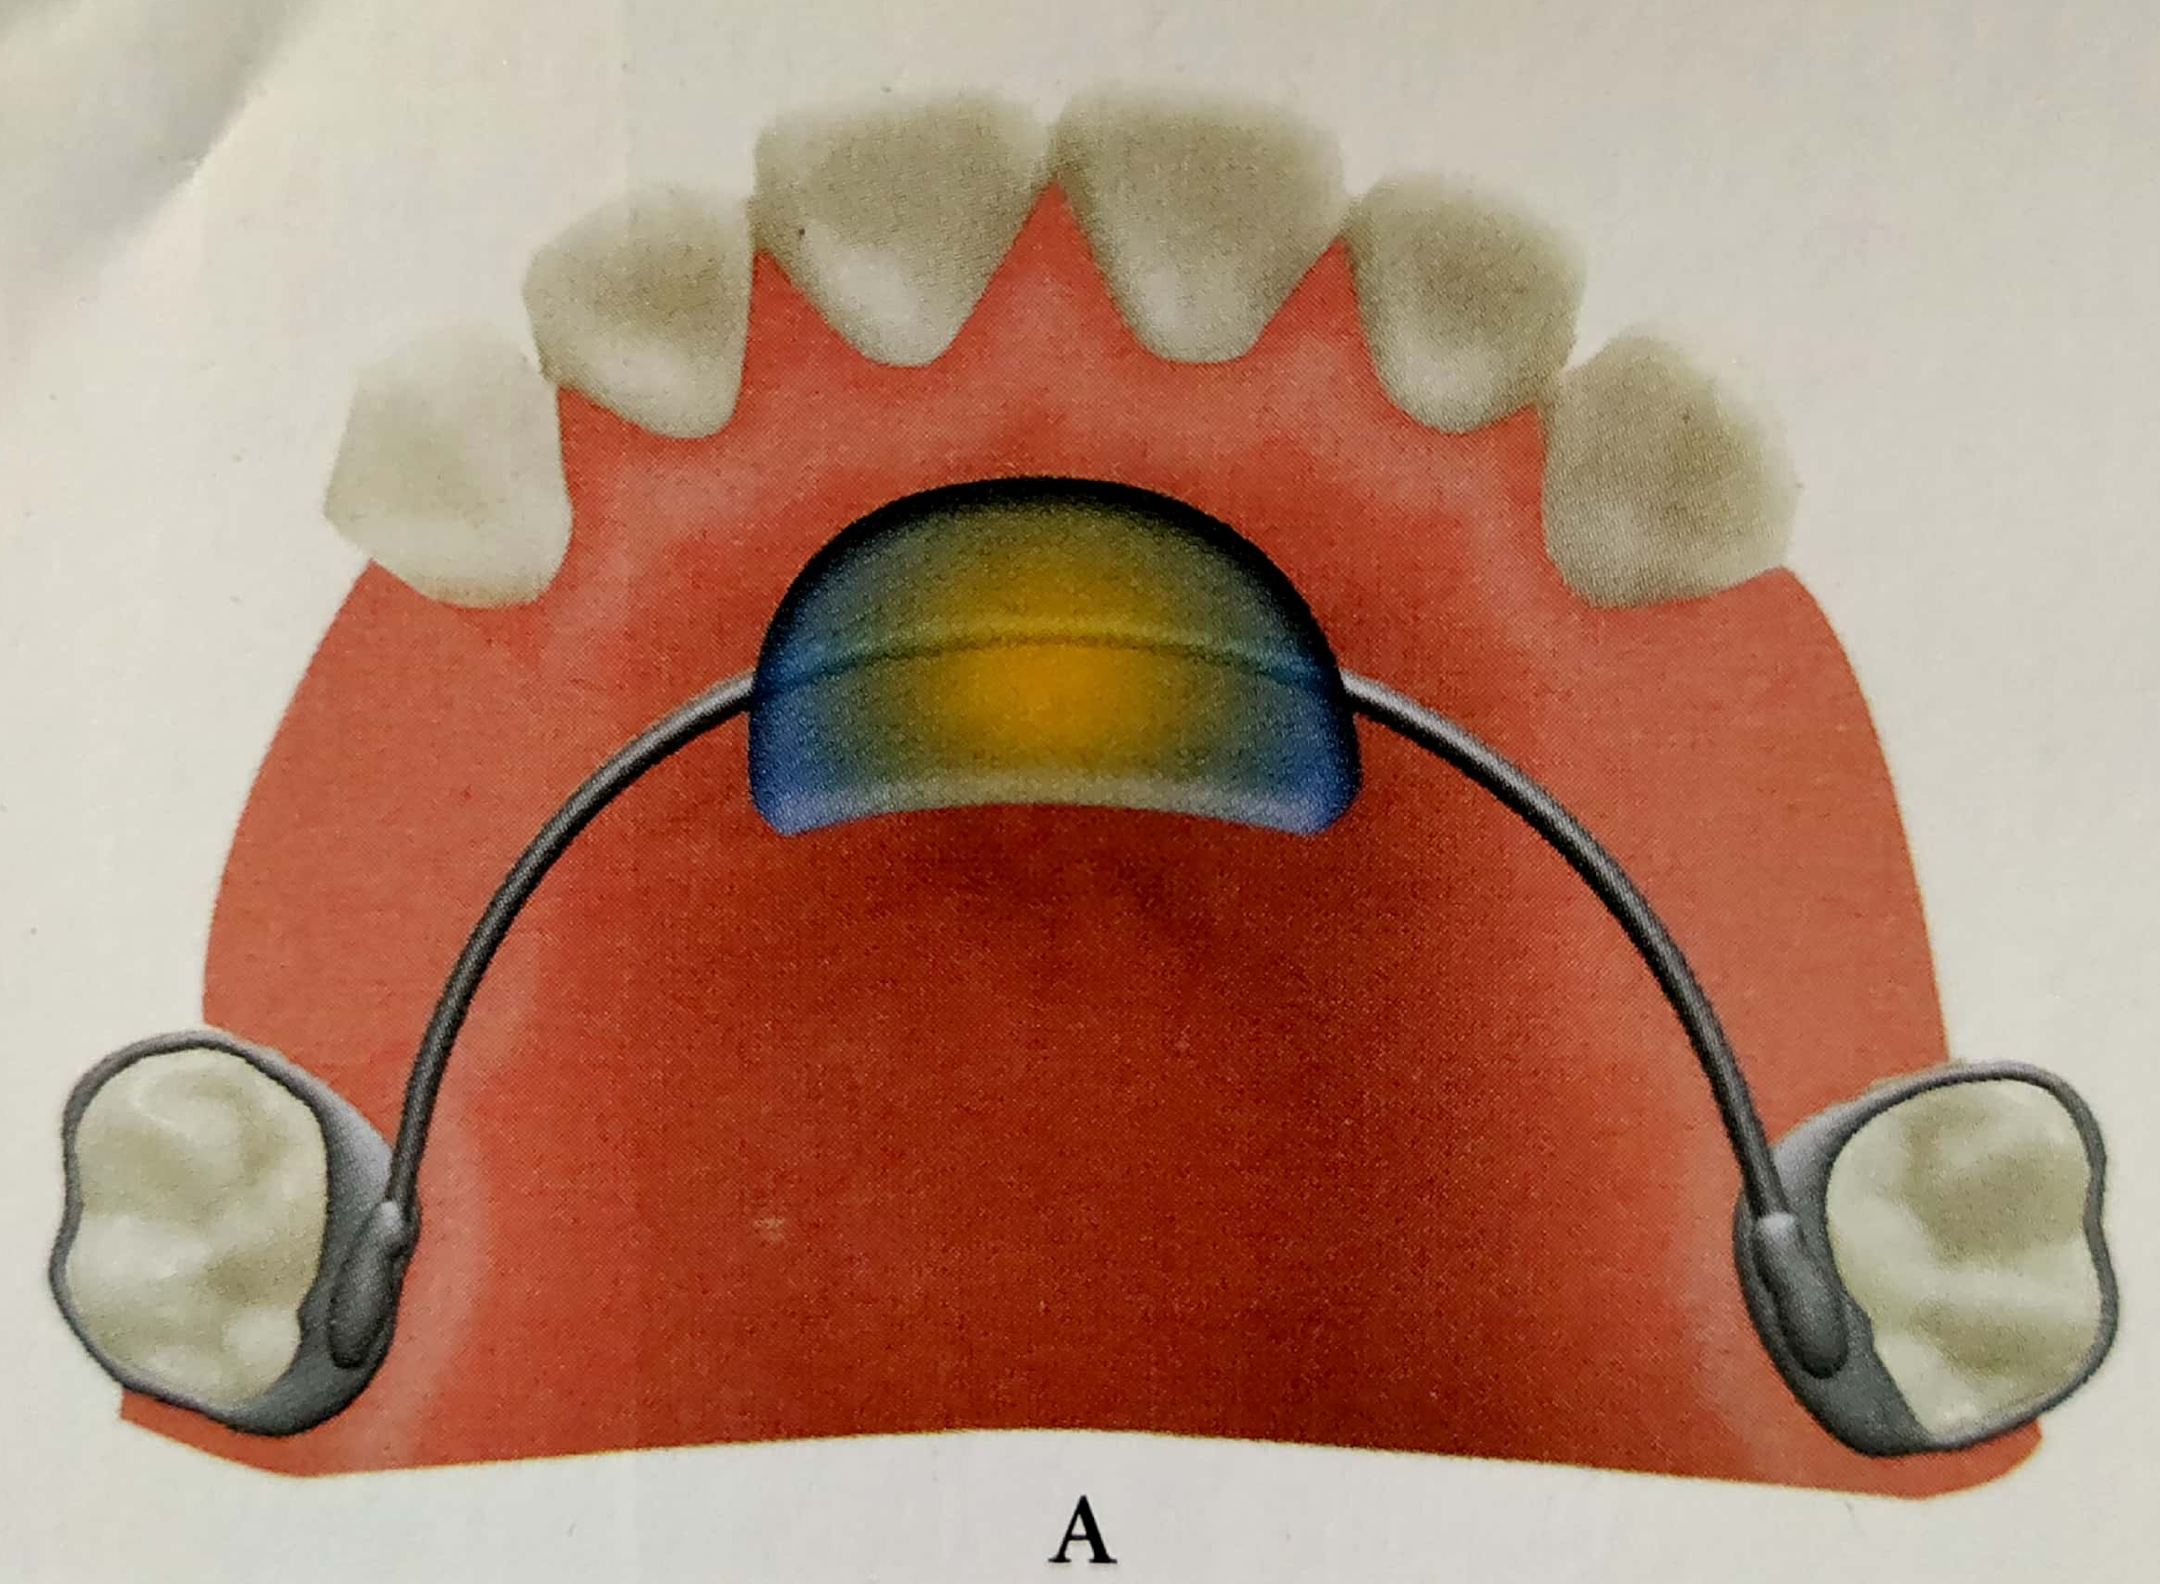
Palatal arch appliances

Slide 21
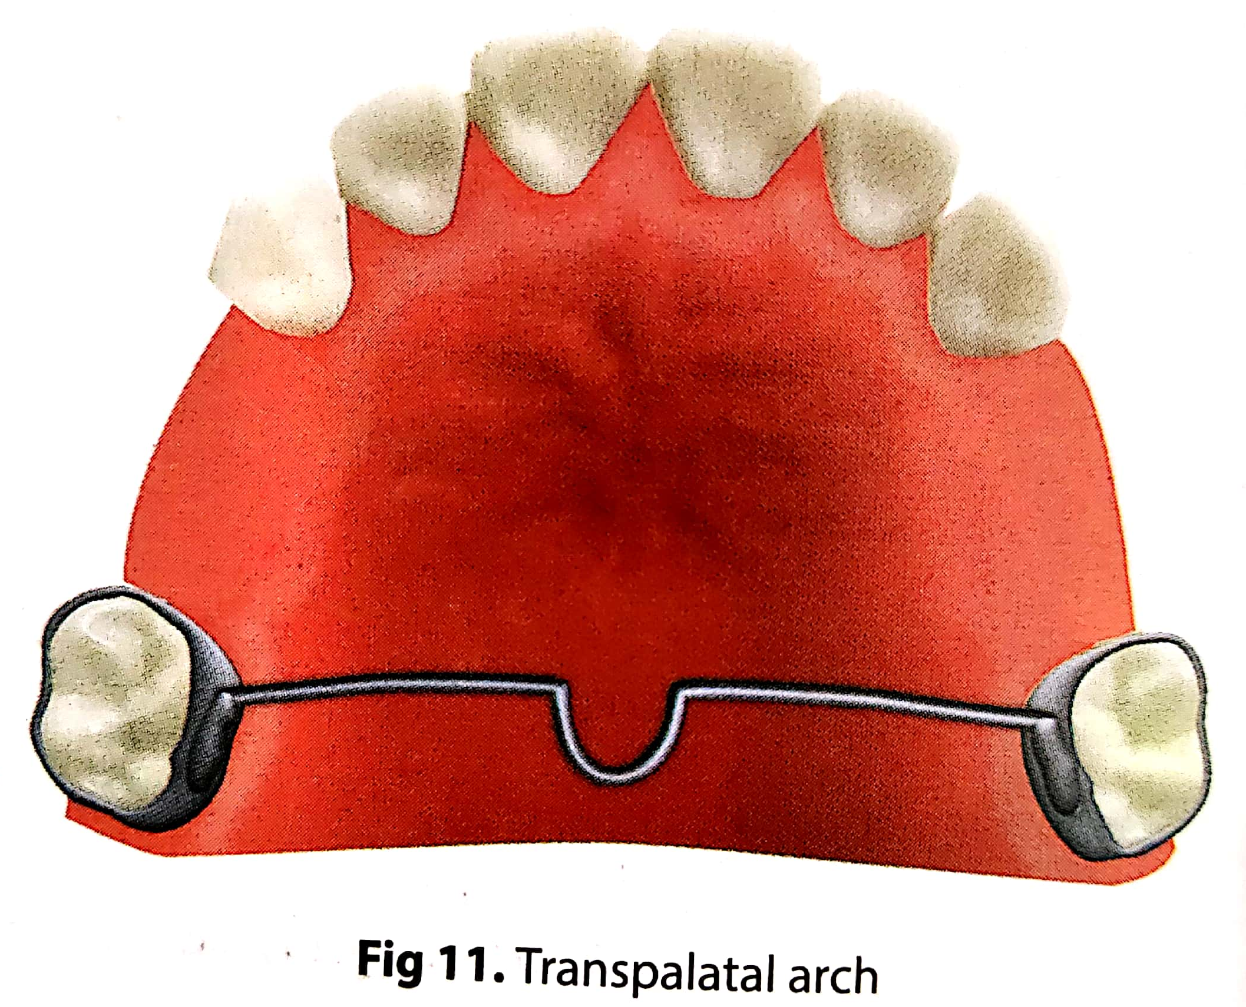
Transpalatal arch

Slide 22

Distal shoe space maintainers
It is also called intra alveolar appliance

Slide 23
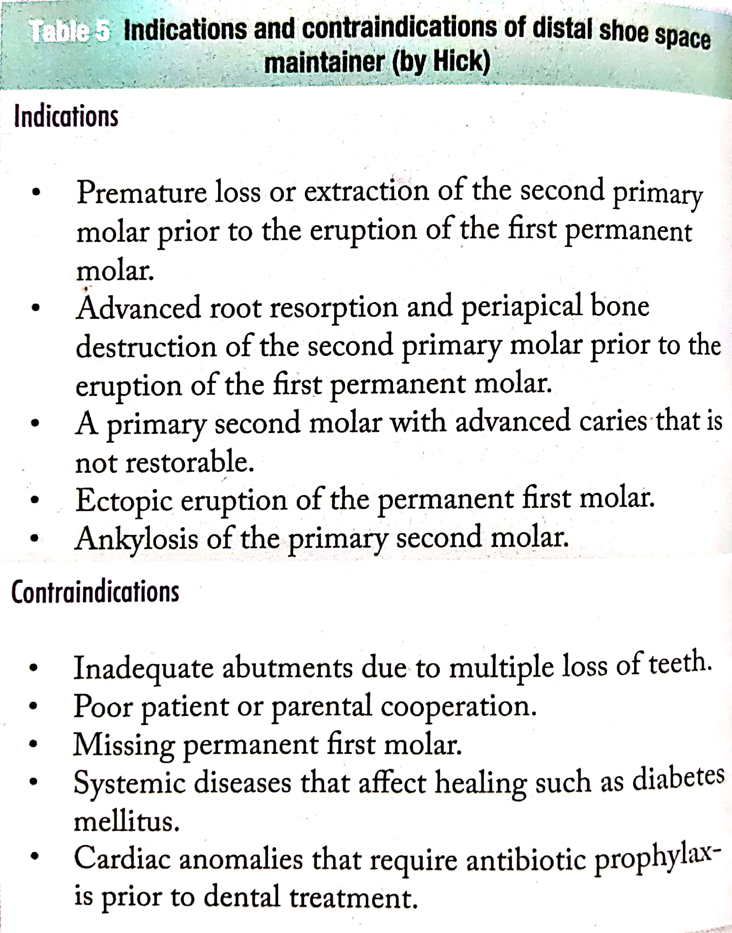
Indication of distal shoe space maintainers

Slide 24
Contraindication of distal shoe space maintainers

Slide 25
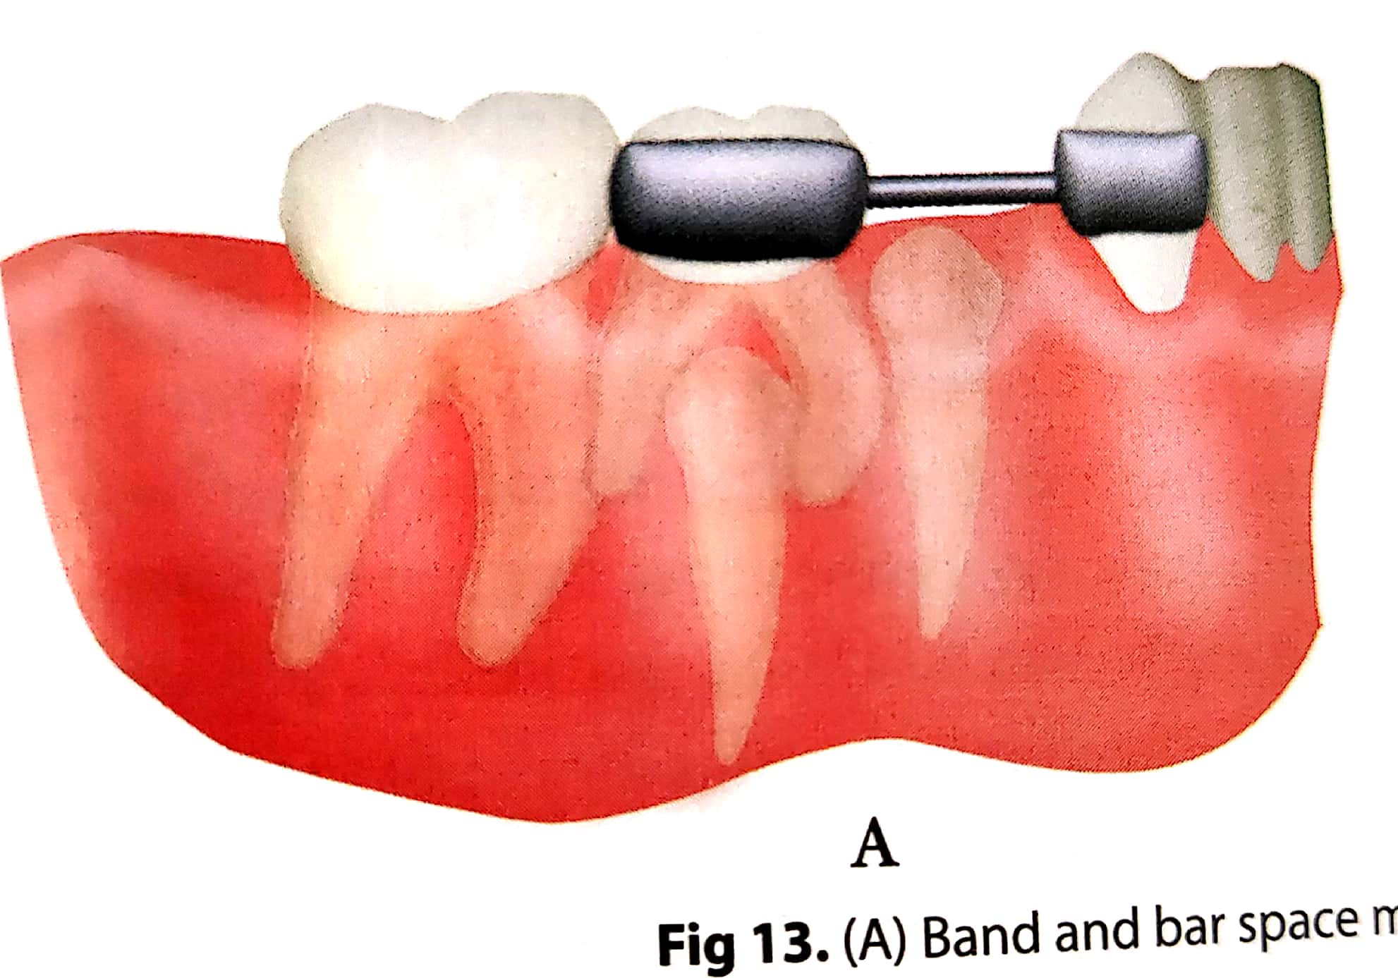
Band and bar type space maintainers

Slide 26
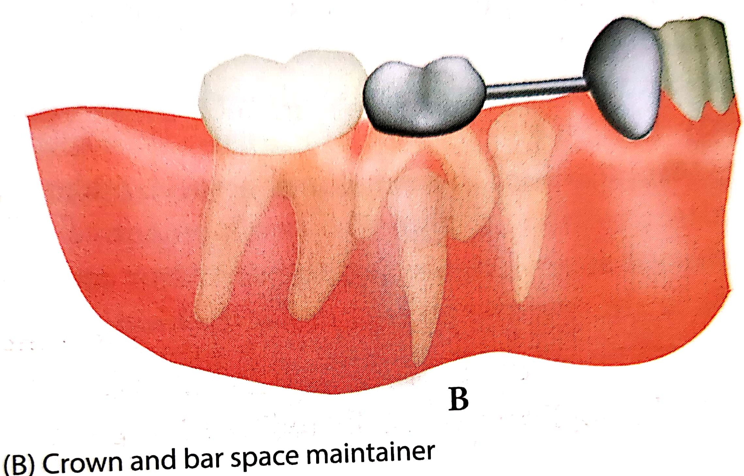
Crown and bar space maintainers.
Here stainless steel crowns can be used on the abutments. This type of space maintainers is called crown and bar space maintainers.

Slide 27
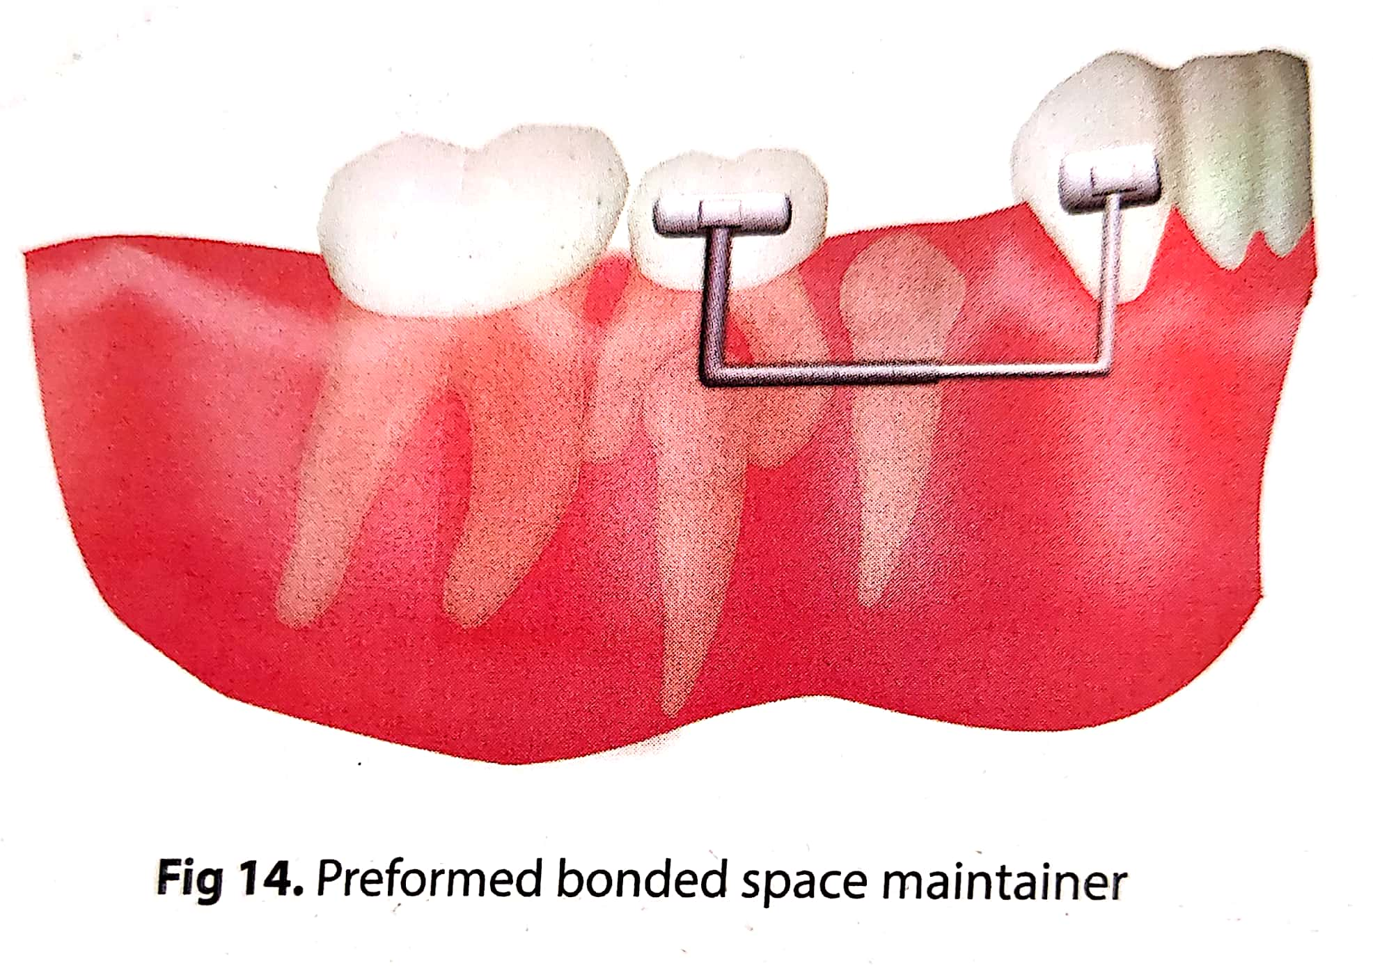
Preformed bonded space maintainers

Slide 28
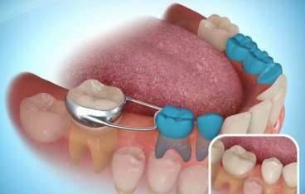
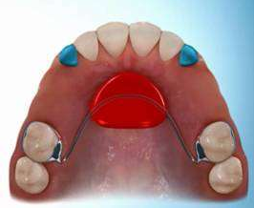
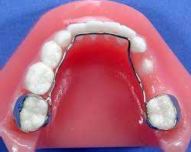
13) Space maintenance
Cont…
Fig: Different Type of Space Maintainer

Slide 29
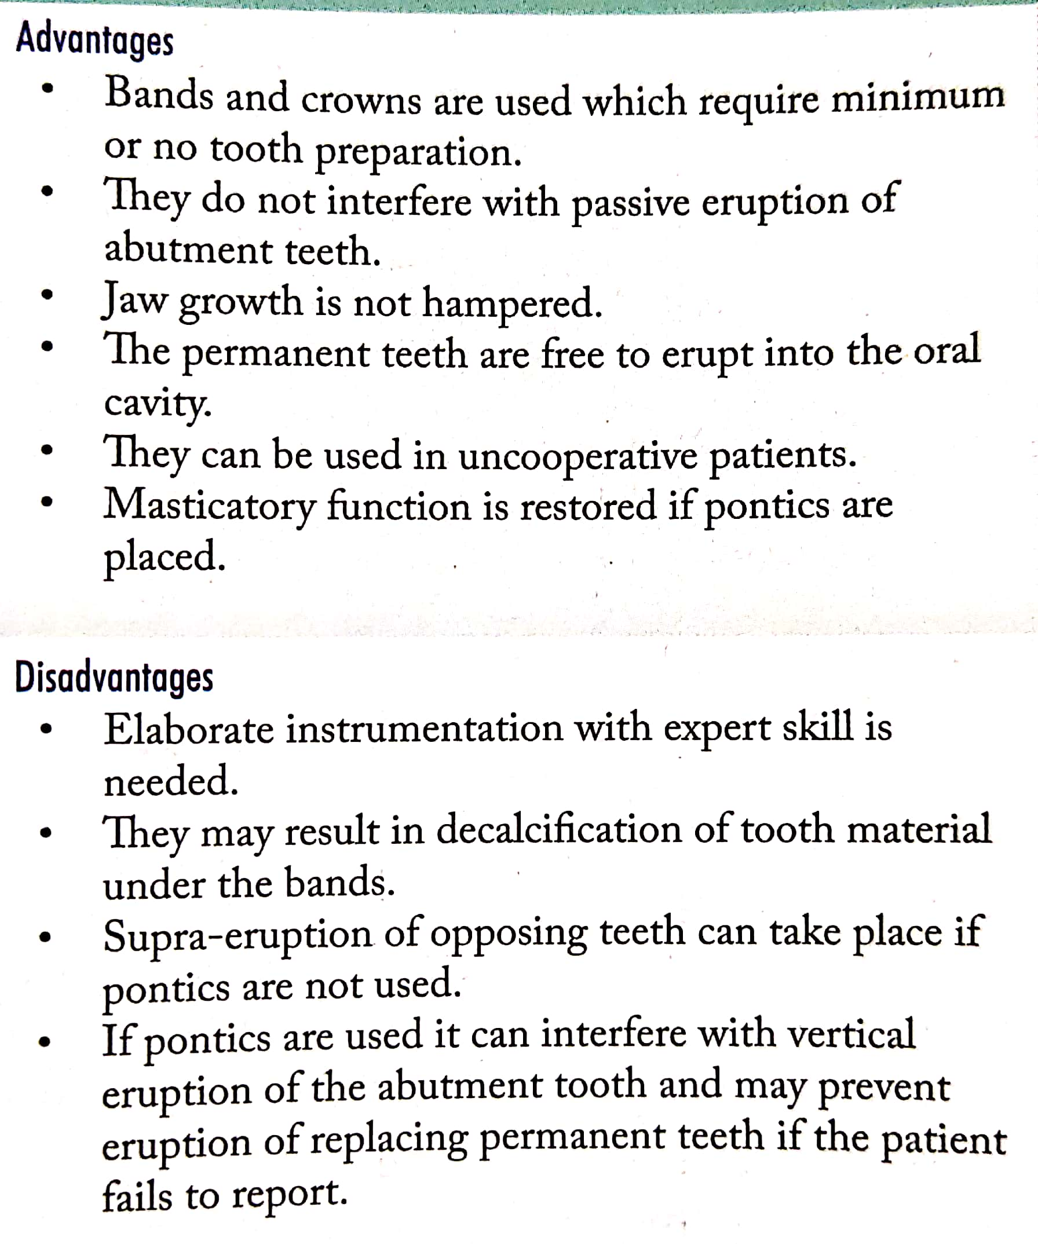
Advantages and disadvantages of fixed space maintainers.

Slide 31
SUMMARY
As the word goes, PREVENTION IS ALWAYS BETTER THAN CURE, preventing orthodontic malocclusion at a very early age can do so much good for the children than interceptive and corrective procedures at a later age. Hence it is the need of the age. for children and parents to be well informed, educated and motivated to take preventive measures
1. The dentist must aware of normal development of occlusion during primary & mixed dentition.
2.know the development of dentition & sequence of eruption of teeth.
3. Accurate & periodic oral examination of child to diagnose defects in the teeth or dental arch or soft tissues like frenum.
3. Early diagnosis of incipient caries by periodic cheek up using bite wing film.
4. Preservation of arch length by accurate restoration of proximal contact areas using 1 band with wedge & good amalgam.
5. Detection of any speech defect.
6.Detection of breathing way & swallowing mechanism.
7. Prevent early loss of primary dentition.

Slide 32
REFERENCES
Textbook of Orthodontics – Gurkeerat Singh, Jaypee Brothers; 2nd Edition
Orthodontics – The Art and Science, S.I Bhalajhi, AryaMedi Publishing; 7th Edition
Textbook of Orthodontics – Sridhar Premkumar, Elsevier; 1st Edition
Orthodontics: Diagnosis and Management of Malocclusion and Dentofacial Deformities – O.P Kharbanda, Elsevier; 1st Edition

Slide 33
Question & Answer Session

Slide 34


